Slide 1

International Accountability Project – Developing Project Alerts
Data Ambassadors: Kush Varshney, Shubin Li
Project Champions: Ryan Schlief, Preksha Krishna Kumar

Slide 2
International Accountability Project (IAP) - Background
International development projects are often designed and implemented without their experience or expertise. Without considering their priorities or involving them at the earliest stages, development projects can cause harm.
Development is often overly technical and inaccessible. Project information and the methods by which affected people can bring their concerns are not available or identified.
The exact sector and location of a major project as well as how the government and development finance institution have measured the potential human and environmental rights impacts is often missing.

Slide 3
IAP Early Warning System – part of the solution
Web-based tool to organize, summarize and standardize projects at 13 development finance institutions
Exposes trends in development by sector, bank, geography and community response
Can benefit from automation

Slide 4
Our Task #1
A more systematic process of tagging news articles with sectors and country
Dataset: Feedly daily news feed from different media
Challenge: Build a sector/country filter to categorize news articles

Slide 5
Our Task #2
A more systematic process of tracking funding project updates
Dataset 1: EWS web-scraped projects from major development banks
Dataset 2: Feedly daily news feed from different media
Challenge: Generate an automated process to match social media dataset with specific funding project proposals

Slide 6
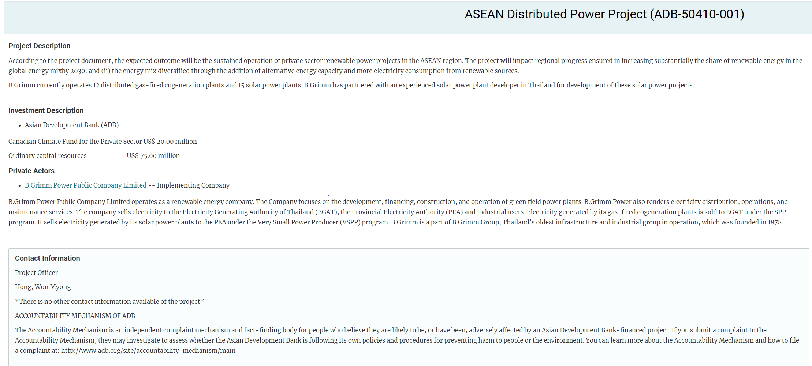
International Accountability Project (IAP)
EWS Project Data

Slide 7
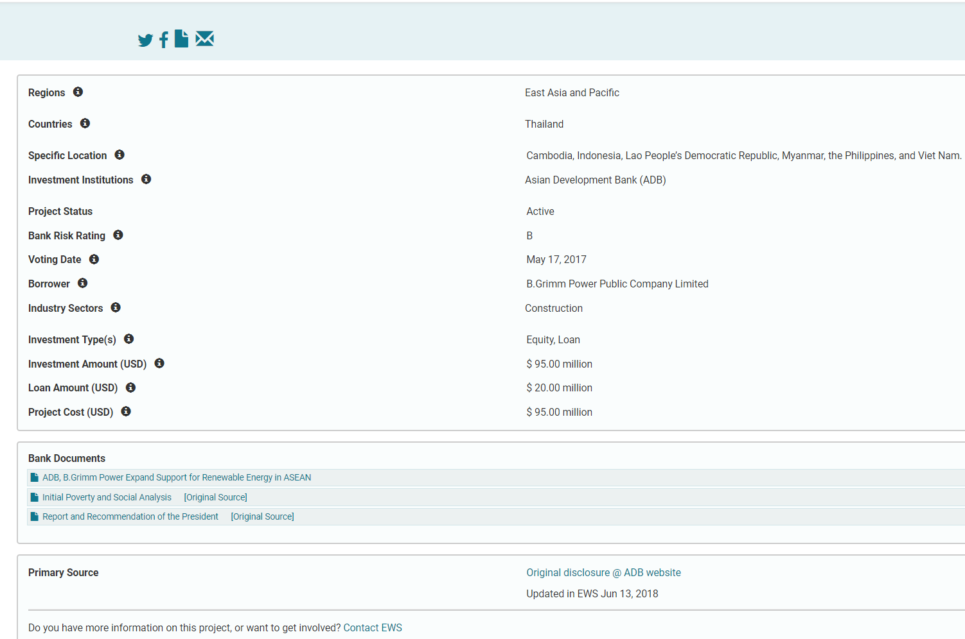
International Accountability Project (IAP)
EWS Project Data

Slide 8
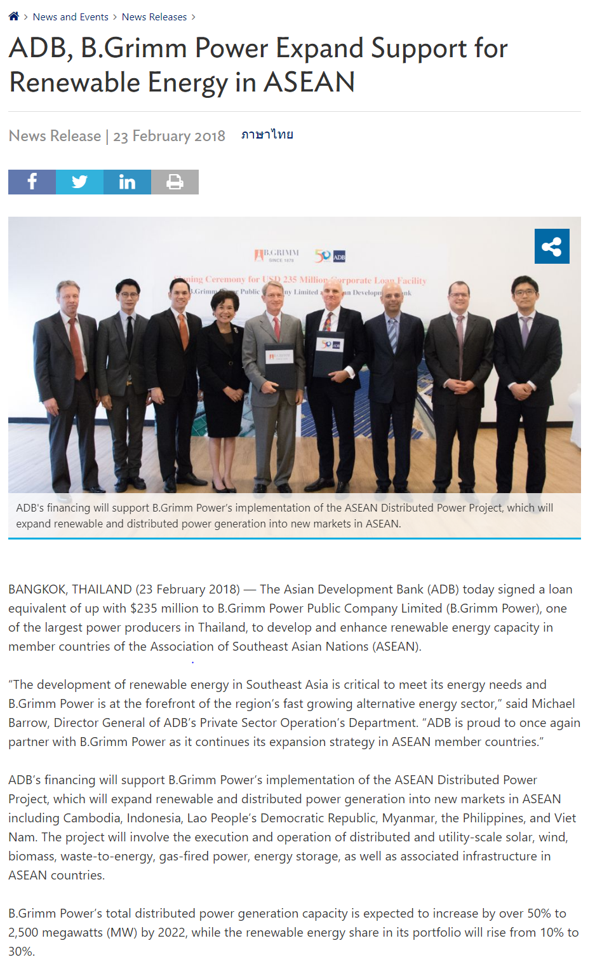
International Accountability Project (IAP)
Media

Slide 9
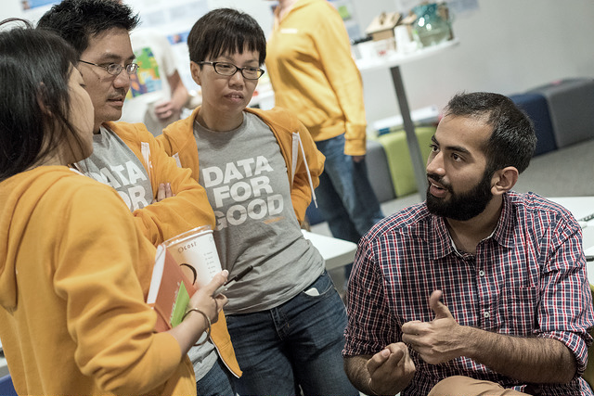


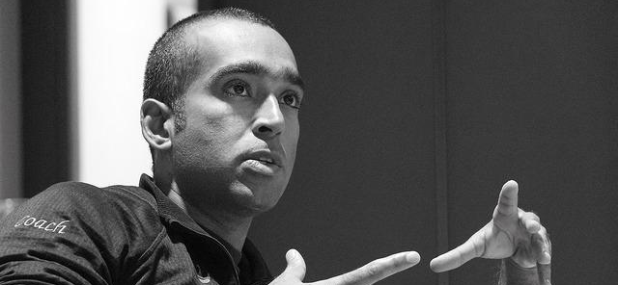
BIG CHALLENGE
NEEDED SKILLS
YOUR MISSION

Slide 10


Big Challenge
semantic matching

Slide 11
Big Challenge
Understanding articles and projects is difficult
Matching articles and projects could generate many false positives
Training dataset is small

Slide 12
Needed Skills
For most of the work
Basic coding skills in Python
Basic modeling skills: logistic regression, or other advanced machine learning techniques like random forest, gradient boosting method
For our big challenge
Natural language processing, word2vec
Data enthusiast? Student? Just want to try your hand at a project?
Manual classification and training-set expansion

Slide 13
Your Mission
Well-defined end to end machine learning projects
Prototype/MVP tool empower people to increase their awareness of development activities in their local community

Slide 14
Join us! Come talk to us about this exciting project during throughout the evening.

